Slide 1
National Record Locator
Presented by
The NRL Team

Slide 2
Agenda
Introductions
What does it do?
How does it work?
Usage Statistics and National Coverage
IG Overview
What Next?
Prerequisites & Onboarding
Case Studies / User Feedback

Slide 3
Introductions

Slide 4
The Vision:
The National Record Locator (NRL) is a national index of pointers to patient records. It enables an authorised clinician, care worker and/or administrator, in any health or care setting, to access a patient’s information to support that patient’s direct care.
The Principles:
The NRL integrates patient record access across the NHS and Social Care without dictating where those records might be stored, thus realising a level of national interoperability across the service which has previously been unachievable
NRL is NOT a central data store for patient records
It is an index that provides the location of records, the technical means to retrieve them, underpinned by an IG framework to safely support sharing on a national scale
Notes:
NRL has huge potential for a wide number of use cases and stakeholders.
However, the strategy is one of iterative development.
Each new release offers more functionality and benefit to a wider range of users.

Slide 5
What does the National Record Locator (NRL) do?

Slide 6


NRL enables cross border record sharing on a national scale
Lancashire Care
NRL is connecting local and regional sharing initiatives such as LHCRs, Shared Care Records, software supplier associations, and individual trusts, giving them all a national presence
MENTAL HEALTH CRISIS PLAN
Patient lives in Preston
London Ambulance
To scale this up nationally, local data sharing agreements are insufficient. More on this later….
Receive 999 call
Treat patient
Retrieve plan from Lancashire Care via the NRL
Patient travels to London
Requires emergency care and calls 999

Slide 7
Basic Concepts
The NRL is an INDEX of pointers that is used to locate patient records nationally
A Pointer is an entry on the NRL index that points to a single record associated with a patient
A Provider is an organization that makes patient’s records available on the NRL and is responsible for uploading pointers to the NRL (e.g. a care home making End of Life plans available)
A Consumer is an organisation that accesses the NRL to view pointers for a specific patient and retrieve their records for the purposes of Direct Care (e.g. Ambulance Services consuming End of Life plans)
A Consuming Application is used by the consumer to view pointers on the NRL and retrieve records. The consuming application could either be a supplier application integrated to the NRL API or it could be the NHS Digital provided SCRa (Summary Care Record Application). The following slides show examples of the SCRa

Slide 8
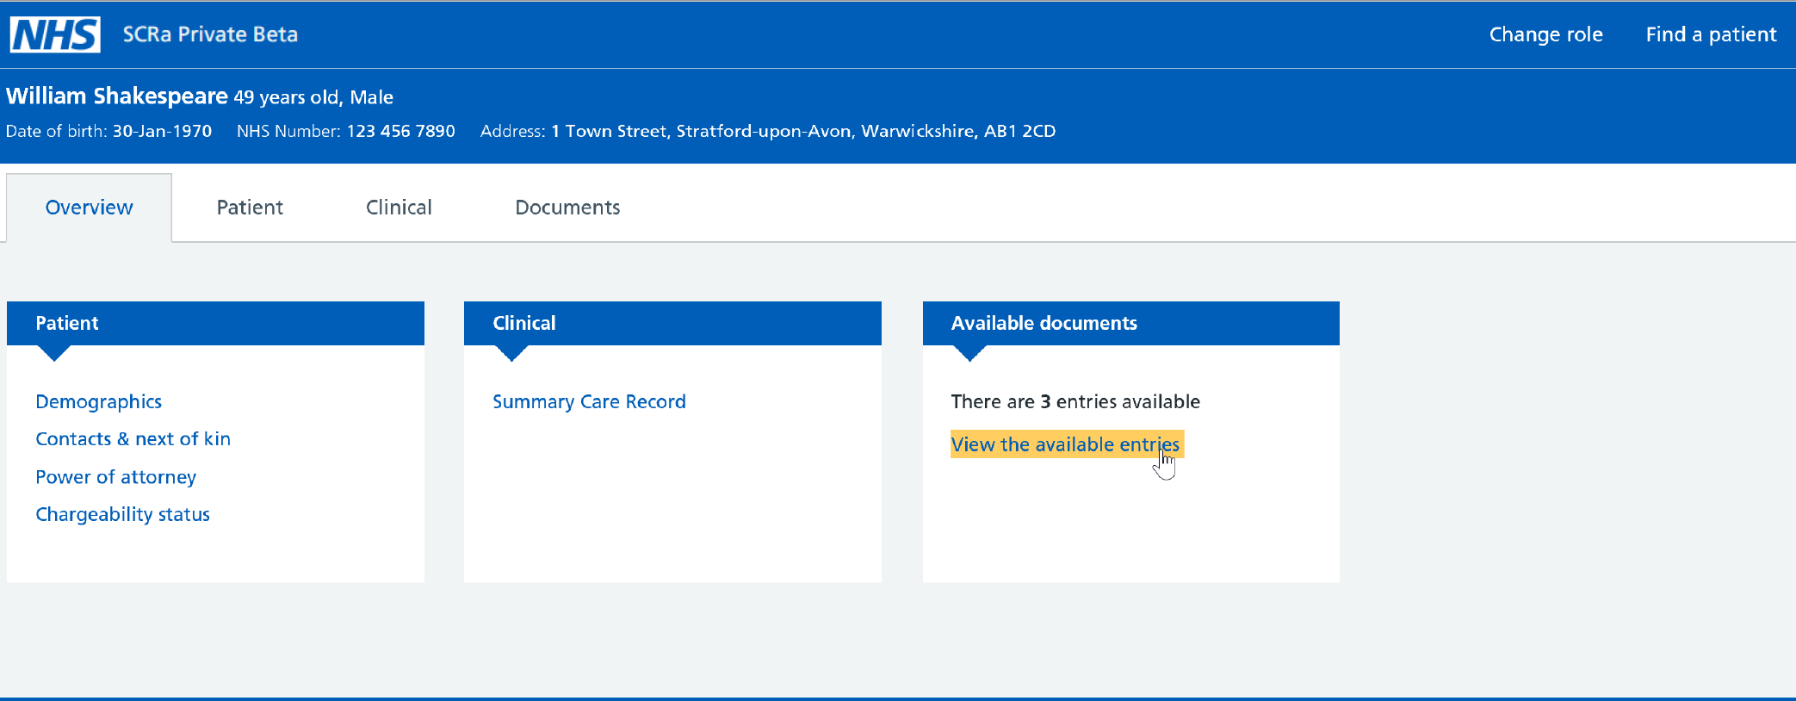
New SCRa – landing page

Slide 9
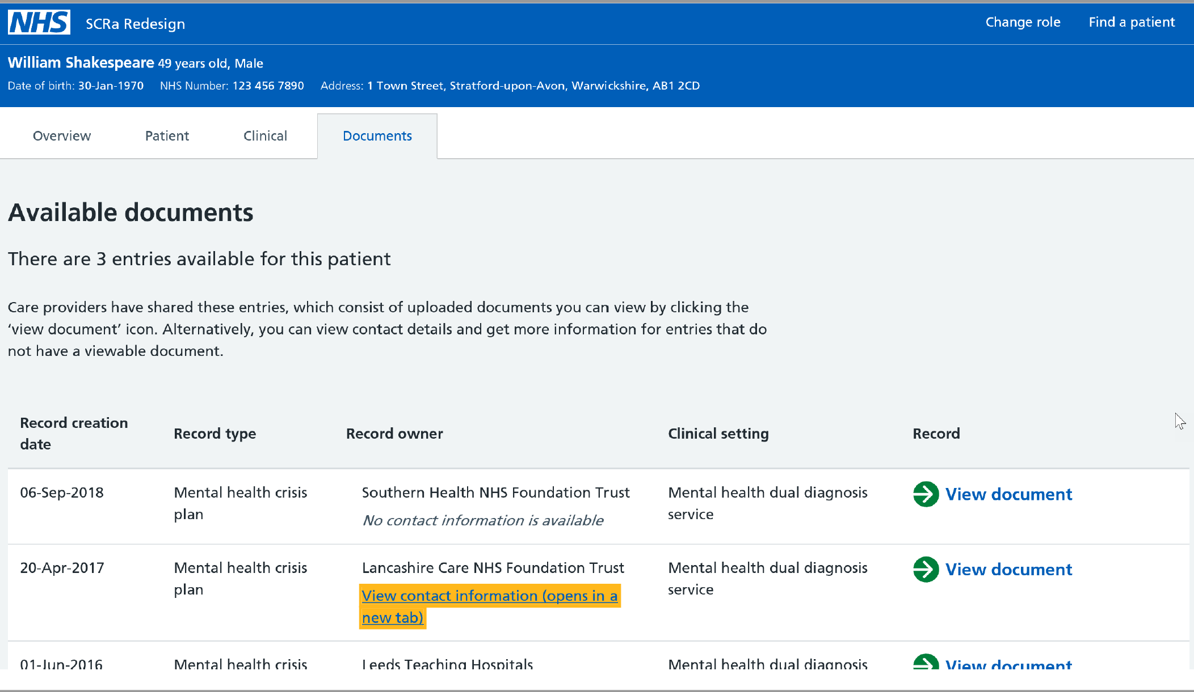
New SCRa - Pointer list view

Slide 10
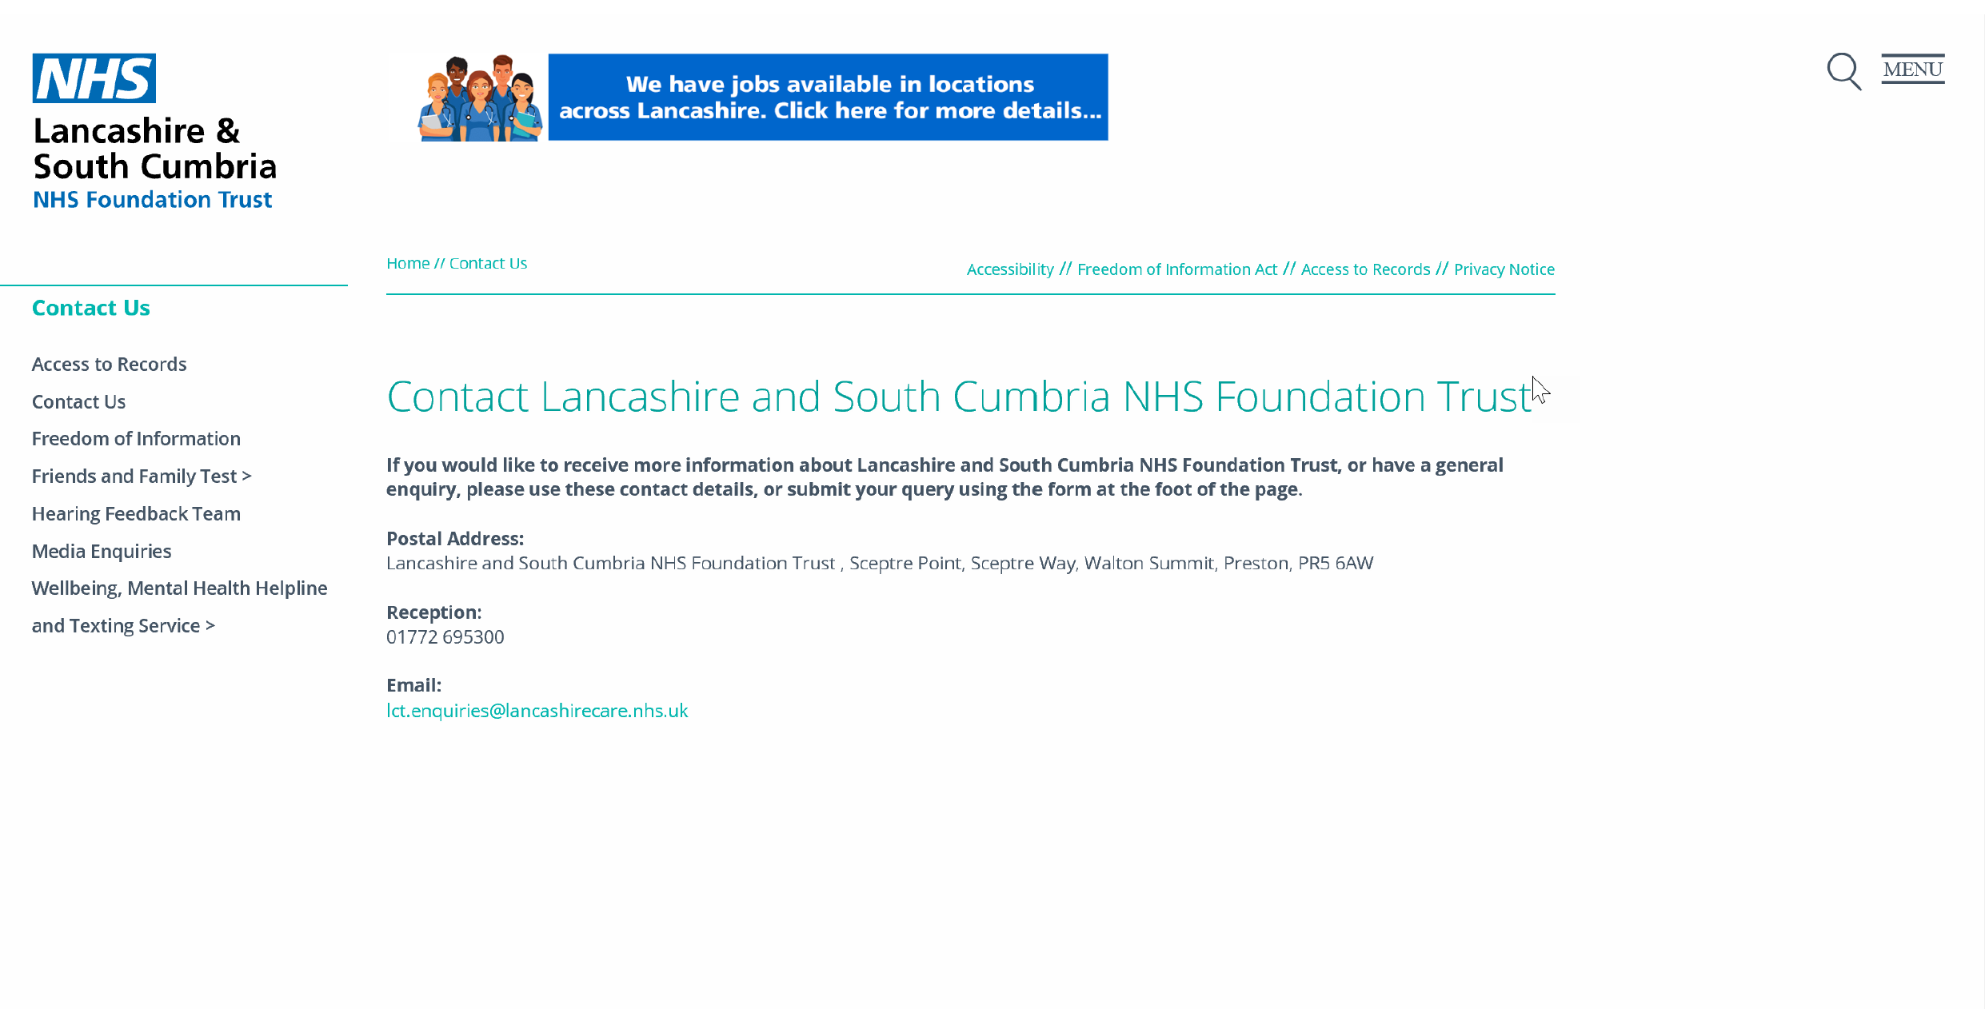
Optional - Provider Contact Details (available on the WWW)

Slide 11
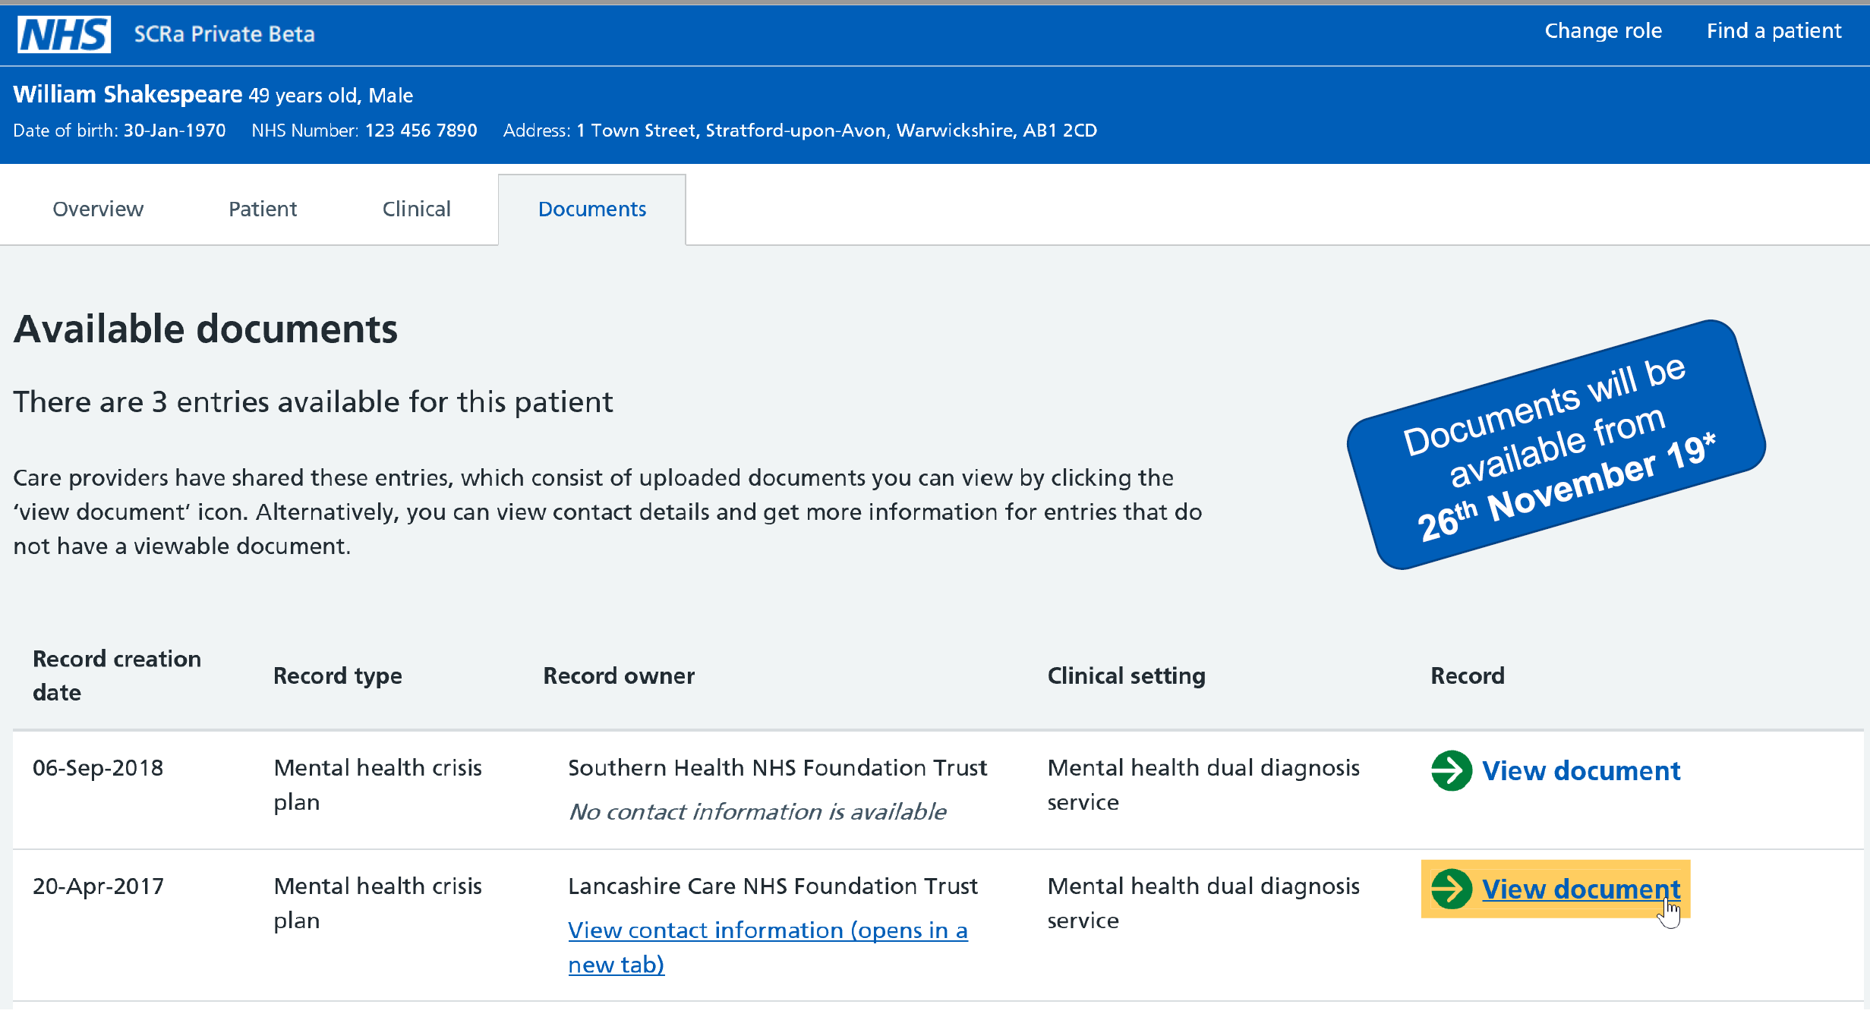
New SCRa - View document link
Record Retrieval LIVE December 2019

Slide 12
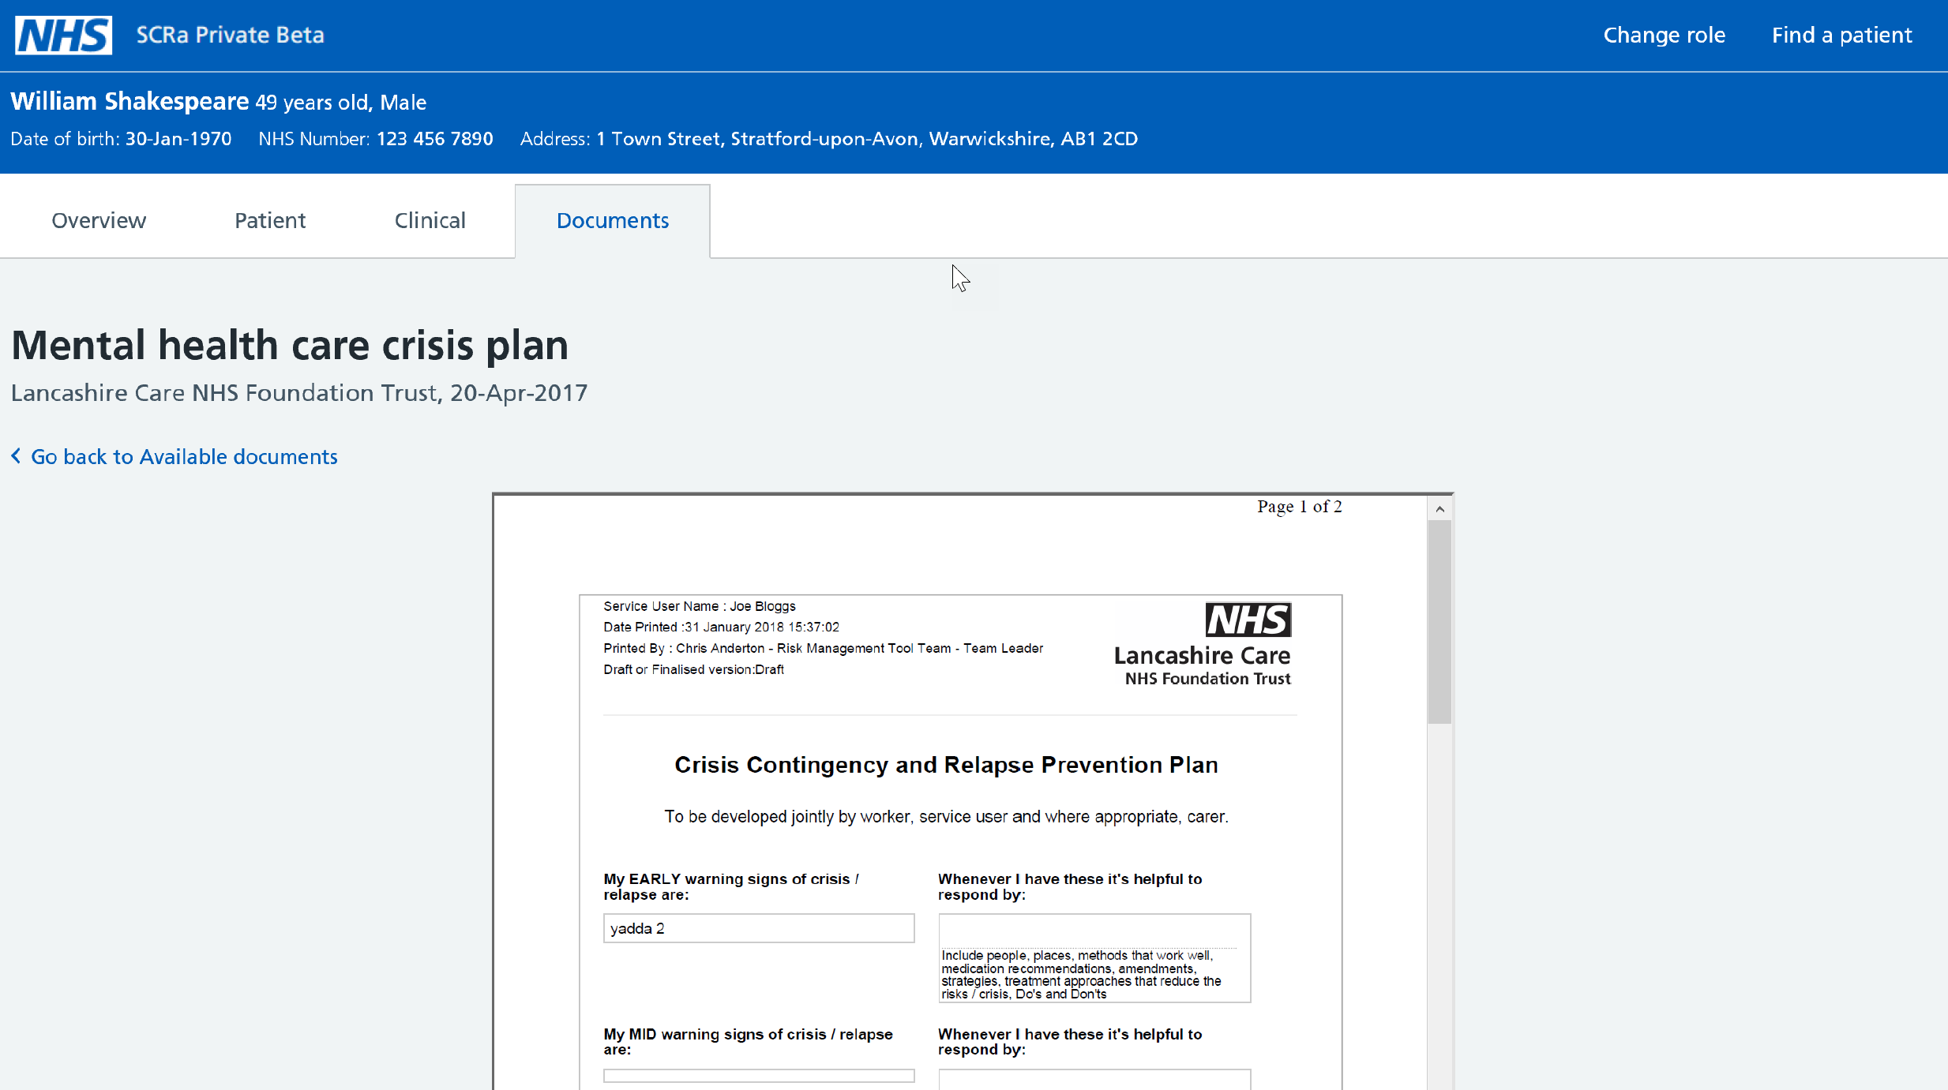
New SCRa - Record Retrieval
Notes:
NRL technically enabled record retrieval in December 2019, just one year after NRL went live with pointers to crisis teams contact details for a patient.
South London and Maudsley NHS Foundation Trust was the first mental health trust to enable the retrieval of their records on NRL (National Record Locator) from 20th February 2020 and despite not being in the same locality on the 1st March 2020, Sean Te Haara, a London Ambulance Advanced Paramedic Practitioner, was the first to use NRL to retrieve a mental health crisis plan.
This enabled him to deliver better care to the patient at the scene. The patient’s crisis plan was made available to him on his iPad by leveraging the functionality provided by the NRL in conjunction with new SCRa (Summary Care Record Application) and the NHS Identity Service to deliver a secure and mobile solution on iPads in the North West London region. This is the first example whereby three integrating care programmes have combined to deliver benefit directly to frontline clinicians and assist in delivering better care to patients, based on their physical and mental health.

Slide 13
How does NRL work?

Slide 14







NRL Overview
Patient record
Search NRL and
view pointers
NRL
Create
Pointer
2
Retrieved record can be viewed by:
Desktop SCRa
Mobile SCRa
Directly integrated consumer application.
1
NRL PROVIDER
NRL CONSUMER
Request record
Request record
SPINE
SECURE
PROXY
4
5
If also sharing
contact details of
team directly
caring for patient
(e.g. Mental Health
Crisis Team), then these
must be publicly available
Return record
Retrieve and view record
3
View contact details using browser
WWW

Slide 15
Service Features
Pointer model aligned with both FHIR and IHE standards to accommodate broad spectrum of use cases and LHCR (Local Health Care Record) integration
Record Retrieval via SSP (Spine Security Proxy) integration, enabling retrieval of patient records (currently limited to PDF format)
SSP (Spine Secure Proxy) is a content agnostic forward proxy that provides a single, central security point for both authentication and authorisation for all connecting systems
New SCRa (Summary Care Record Application), can be accessed via a Desktop Browser or via an I-Pad, integrated with NHS Identity
Option to provide contact details for the individual or teams caring for patient in addition to direct record retrieval

Slide 16
Usage Statistics and National Coverage

Slide 17
NRL Coverage and Usage
NRL is in use across 5 geographical regions (North West, North East, London, Yorkshire, South West)
Since initial go-live in 2018:
- Over 85,000 Mental Health (MH) crisis plan pointers uploaded
- Over 20,000 searches on SCRa with 8,000 pointers viewed
5 MH Trusts and 2 Shared Care Records providing pointers with 4 Ambulance Trusts consuming

Slide 18
NRL Stakeholders – Connected, In-progress (onboarding) and engaged

Slide 19
IG Overview

Slide 20
IG Principles and Legal Basis for Sharing
Direct care
Information: To Share Or Not To Share? The Information Governance Review
Lawful basis
Typically this will be 6(1)(e) ‘…necessary for the performance of a task carried out in the public interest or in the exercise of official authority…’
Legitimate relationship must exist
Consumers to manage locally. Must be able to prove.
Must have IG roles in place to support NRL
Caldicott Guardian, Data Protection Officer, Privacy Officer
Article 6(1)(e) ‘…necessary for the performance of a task carried out in the public interest or in the exercise of official authority…’
Article 9(2)(h) ‘…medical diagnosis, the provision of health or social care or treatment or the management of health or social care systems…’
Notes:
IG Principles
For Direct Care
Lawful basis
A legitimate relationship must exist to access records and full auditing is required from a consumer and provider side.
Must have IG Roles

Slide 21
Access Control Model
NRL Consumer A
NRL
NRL Providers
Organisational
Restriction
NRL Consumer B
NRL Provider makes record available on NRL
Records available to NRL Consumers based on their organisation type

Slide 22
Other Existing Controls
User Access
Authentication: Smartcards / NHS Identity
Authorisation: NHS Digital defined RBAC
Professional Responsibilities
Professional code of conduct
Maintaining confidentiality
Organisational Responsibilities
Audit
Disciplinary measures
Monitoring
Notes:
User access: as per NRL Business Requirements
Professional responsibilities: if in breach, individual is at risk of disciplinary measures, professional de-registration and legal proceedings.
Organisational responsibilities: as signed up to in the onboarding documentation

Slide 23



Authentication – Smartcards & NHS Identity
Smartcard / NHS Identity
System auth.
NRL
Consumer
Pointer
NRL / SSP
Pointer
NRL
Provider
Record
Smartcard / NHS Identity
Notes:
User access: as per NRL Business Requirements
Professional responsibilities: if in breach, individual is at risk of disciplinary measures, professional de-registration and legal proceedings.
Organisational responsibilities: as signed up to in the onboarding documentation

Slide 24
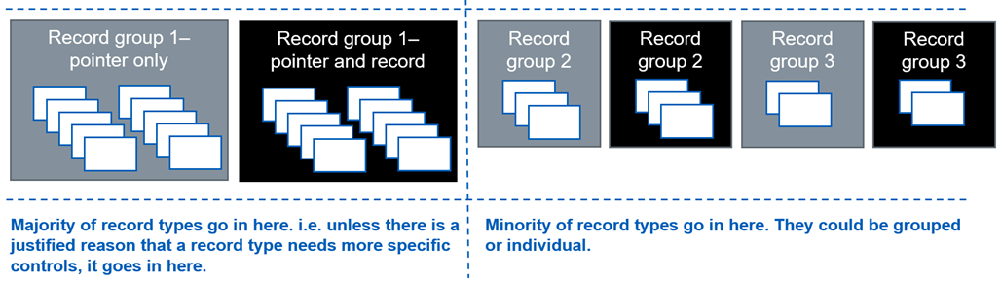
Authorisation – RBAC Model
Record Group | Record Types Contained | Access Level | RBAC Code
Record Group 1 | Mental health crisis plan | Pointer only access | B0268
 |  | Pointer and record access | B0269
Notes:
User access: as per NRL Business Requirements
Professional responsibilities: if in breach, individual is at risk of disciplinary measures, professional de-registration and legal proceedings.
Organisational responsibilities: as signed up to in the onboarding documentation

Slide 25
Audit Requirements
Central NRL audit log
All requests
User, Org & System details
Consumer audit log
Get & Read requests
User, Org & System details
Provider audit log
Post, Patch, Get & Delete requests
NHS Number
Response outcome and body
NHS number
User, Org & System details
NHS number
Response outcome and body
Consumer audit log
Requestor details
SSP audit log
Trace ID
Provider audit log
Requestor details
Record version
Trace ID
Record URL
NHS Number
Pointer ID
Trace ID
Requestor details
Response outcome
No clinical data
Request details
Pointer
Record
Retention periods
As per NHS Digital’s specified requirements:
“…APPLICATION DATA will be kept for the life of the patient, plus an additional 30 yrs..”
Notes:
User access: as per NRL Business Requirements
Professional responsibilities: if in breach, individual is at risk of disciplinary measures, professional de-registration and legal proceedings.
Organisational responsibilities: as signed up to in the onboarding documentation

Slide 26

IWG - Interoperability Working Group
Scope:
The group will govern the definition and design of event, encounter and pointer types for use cases wishing to exploit the NEMS and NRL services.
Purpose:
To ensure NRL pointer types remain ‘generic’ for use by multiple
parties, with appropriate standards (data, architecture and business)
applied and managed consistently. Considerations include:
Participants:
Technical Architecture, IOPS, Data Standards, Terminology, Clinical, IG and DPO, Live Services, SME (e.g. Business analysts), and Programme (where applicable).
Is there a lawful basis and legitimate relationship?
Is it being used for Direct Care purposes only?
What is the purpose and lawful basis for sharing?
What type of organisations can view a particular pointer type?

Slide 27
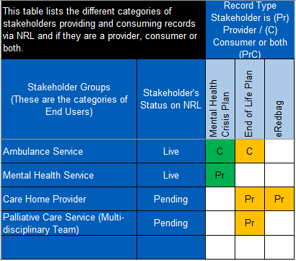
Authorised Service Users Catalogue
The Authorised Service Users Catalogue gives visibility to all users of the NRL of both the type of users with access (e.g. Ambulance Service, Care Home Provider etc) as well as a comprehensive list of the organisations themselves.
This is especially important for NRL Providers in ensuring they are fulfilling their responsibilities as a data controller

Slide 28
What Next?

Slide 29
Upcoming Service Enhancements
Direct integration for Consumers enabling access NRL without using the SCRa
Integration with LHCRs
Transition to Live Services
Availability of mobile SCRa on other device types (i.e. Windows, Android)
New Record Types – Care Plans, Health Child Records, Frailty & Disability etc.
Retrieval of Structured Records (currently limited to PDF)

Slide 30
Pre-requisites & Onboarding

Slide 31
Provider/Consumer API Integration - Prerequisites
A valid ODS code
Verification of NHS numbers via any of the following mechanisms:
Full PDS Spine compliant system
Spine Mini Service PDS (SMSP)
Demographics Batch Service (DBS) (NRL Providers Only)
N3 or HSCN connection
Appropriate authentication method for accessing data (if Consuming from NRL/NEMS)
Completion of DSPT (Data Security Protection Toolkit) within the last 12 months
Annual Security Testing (to CHECK standards)
Clinical Safety Officer to undertake a Clinical Safety Assessment

Slide 32
Provider/Consumer API Integration - Onboarding Process
Commence any applicable local clinical safety / IG assessments
Review onboarding documentation
Development against online reference implementation
Local testing using TKW
Testing in the NHS Digital path-to-live environments
Complete the Supplier Conformance Assessment List (SCAL)
Sign DSA (Data Sharing Arrangement) and Connection Agreement
Obtain all necessary local approvals for go-live (e.g. clinical safety, IG, board approvals)
LIVE pipe-cleaning
Further detail is included in the NRL onboarding guide (for Direct API Integration).
Technical Specification available here: https://developer.nhs.uk/apis/nrl/

Slide 33
Consumer (SCRa) - Onboarding Process
Commence any applicable local clinical safety / IG assessments
Update local Business Processes and Train Users (guides are available)
Obtain all necessary local approvals for go-live (e.g. clinical safety, IG, board approvals)
Deploy Chrome/Firefox browsers to all users (where not already in place)
Deploy latest NHS Identity Agent to all users (where not already in place)
Deploy National Identity Hub to all users
Add RBAC codes for each user to CIS
Sign NHS Digital DSA (Data Sharing Arrangement) for NRL
Distribute internal comms regarding go-live
Perform Live Validation with a test pointer and record
NHS Digital can guide you throughout the whole process ☺
Further detail is included in the NRL onboarding guide (for Consumers using SCRa only).

Slide 34
Questions?

Slide 35
Contact us:
NRLS@nhs.net

Slide 36
“The patient denied having any MH plan or diagnosis however, this was proven to be false upon viewing the SCRa which made available his mental health crisis plan via NRL. This reassured me that this depressive episode was known and strengthened my thoughts that his Mental Health would need to be managed in addition to his constipation. With this information the GP was notified to raise various social issues the patient was experiencing, with the recommendation that his MH team/family may need to be involved to aid his recovery.”
Sean Te Haara Advanced Paramedic Practitioner London Ambulance
Notes:
This case alone shows the benefits being achieved by NRL, the patient received care based on their specific needs, was not conveyed to hospital and the paramedic was able to make informed decisions based on the information available to him.

Slide 37
“Access to a well populated care plan is the holy grail of information for a paramedic. I’m really excited by care plans, because it tells the story of the patient and the answers to questions in an easy to read format”
Stuart Crichton
CCIO & Consultant Paramedic London Ambulance Service
Notes:
We are live with Ambulance Trusts and Mental Health Trusts currently and are onboarding EoL plans via Caspa, Graphnet and Coordinate My Care.

Slide 38
“Having access to the contact details for a patient and knowing a care plan exists and who I can speak to for more information has saved me time when triaging patients”
Jason Larkin
Mental Health Nurse North West Ambulance Service
Notes:
Quote from a mental health nurse from NWAS.

Slide 39

As taken from the Long Term Plan:
“Ensure that clinicians can access and interact with patient records and care plans wherever they are.”
“In 2020/21, people will have access to their care plan and communications from their care professionals via the NHS App; the care plan will move to the individual’s LHCR across the country over the next five years.”
Notes:
The sharing of care plans has been set out in the long term plan. We are working with LHCRs and non-LHCR areas to share these care plans. We are working with Graphnet, CASPA, Coordinate My Care and others to add pointers to care plans.

